Slide 1
Algorithm Implementation in Game II Session 14
Course : COMP6228 – Artificial Intelligence
Effective Period : February 2018

Slide 2
Learning Objective
After completing this session, students are expected to be able to:
LO 1 : Describe how Artificial Intelligence works in Games
LO 2 : Explain concepts of AI Techniques in Games

Slide 3
Contents
Finite State Machines: Implementation
Rule-Based Systems: Implementation

Slide 4
FSM Implementation
Build a simple social game called The Smile Game (see [2]), where the game is played by two person facing each other and try to make the opponent laugh/smile by making funny faces or jokes. The person who laugh/smile first loses.
[2] Chowanda, A., Blanchfield, P., Flintham, M., & Valstar, M. (2014, August). Erisa: Building emotionally realistic social game-agents companions. In International Conference on Intelligent Virtual Agents (pp. 134-143). Springer, Cham.

Slide 5
FSM Implementation
The goal of the system is to create a virtual human that able to behave naturally, when playing the Smile Game, like human.
The virtual human then will replace one of the human player to play with another human player [2][3].
[2] Chowanda, A., Blanchfield, P., Flintham, M., & Valstar, M. (2014, August). Erisa: Building emotionally realistic social game-agents companions. In International Conference on Intelligent Virtual Agents (pp. 134-143). Springer, Cham.
[3] M. Mancini, C. Pelachaud :Dynamic behavior qualifiers for conversational agents.Intelligent Virtual Agents, IVA'07, Paris, September 2007.

Slide 6
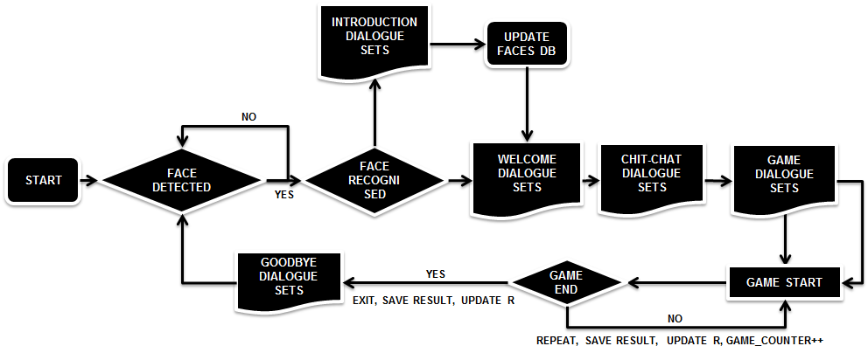
FSM Implementation

Slide 7
FSM Implementation
When the system is initialised, the system will looking for a face. If a face is detected, the system will start a series of conversation before the game is started.
If the face is not recognised, the system will capture a set of the player’s faces and update them to the existing faces dataset/database to be used in the next interaction

Slide 8
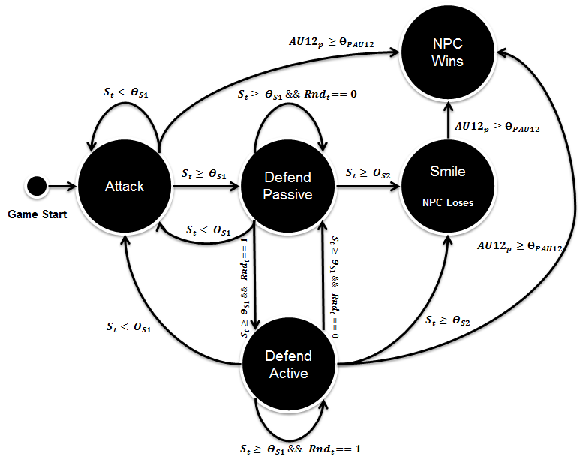
FSM Implementation

Slide 9
FSM Implementation

Slide 10
FSM Implementation
Attack
The virtual human will keep attacking when their urge to smile less than the value of first smile threshold (e.g. 0.5).
If Virtual Human’s urge to smile more than the value of first smile threshold (e.g. 0.5), the virtual human will change their strategy to defend.
Defend Active
Defend active is while the virtual human is defending (i.e. holding their smile), they also move their other facial muscles to attack or make jokes.

Slide 11
FSM Implementation
Defend Passive
There will be a random counter to randomly choice which defend strategy to show.
Smile; NPC Loses
If Virtual Human’s urge to smile more than the value of second smile threshold (e.g. 1.0), the virtual human will laugh/smile and admit their lose.
NPC Wins
If the system detect the player is smiling (i.e. from their facial expressions, Action Unit 12), the NPC will declare as a winner.

Slide 12
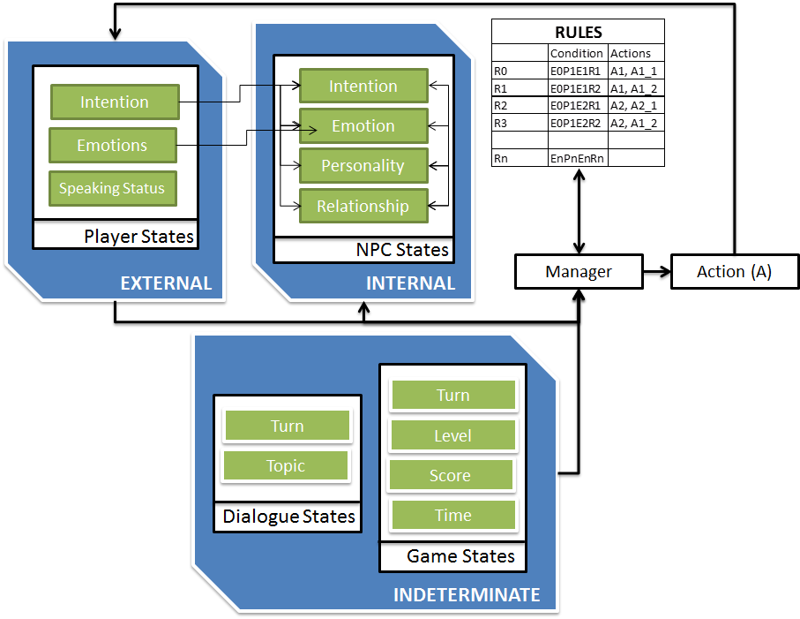
Rule Based System Implementation

Slide 13
Rule Based System Implementation

Slide 14
Rule Based System Implementation

Slide 15
References
Ian Millington. 2009. Artificial intelligence for games. Morgan Kaufmann Publishers. Burlington. ISBN:9780123747310
Playing with Social and Emotional Game Companions, http://www.cs.nott.ac.uk/~pszmv/Documents/IVA_2016_ShortPaper.pdf
Computational Models of Emotion, Personality, and Social Relationships for Interactions in Games, http://trust.sce.ntu.edu.sg/aamas16/pdfs/p1343.pdf
Using Artificial Neural Networks in NPC DecisionMaking Process, https://www.ijcit.com/archives/volume2/issue6/Paper020601.pdf
ERiSA: Building Emotionally Realistic Social Game-Agents Companions, https://pdfs.semanticscholar.org/7917/4bc58d956a8061e191fb76f310ef4588b8fa.pdf

